Slide 1
STATISTIK
Probability
LECTURE:
AL MUIZZUDDIN F., SE., ME.

Slide 2
Key Concept In this section we present three different approaches to finding the probability of an event. The most important objective of this section is to learn how to interpret probability values, which are expressed as values between 0 and 1.

Slide 3
Basics of Probability

Slide 4
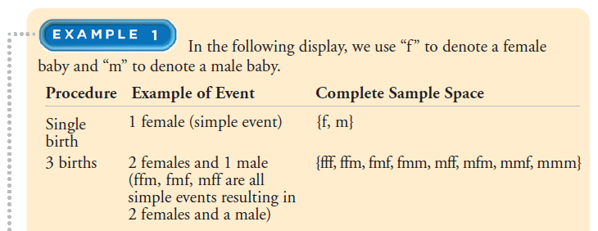

Slide 5
Jenis Probabilitas

Slide 6
Lanjut..

Slide 8
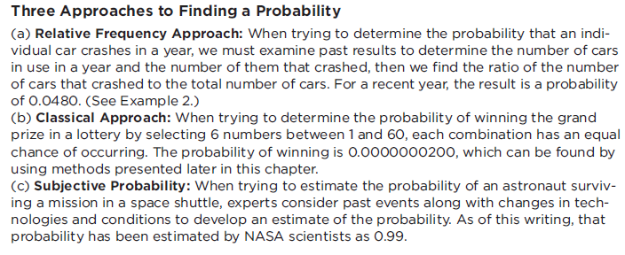
3 pendekatan..

Slide 9
Lanjut..

Slide 10
CONTOH SOAL

Slide 11
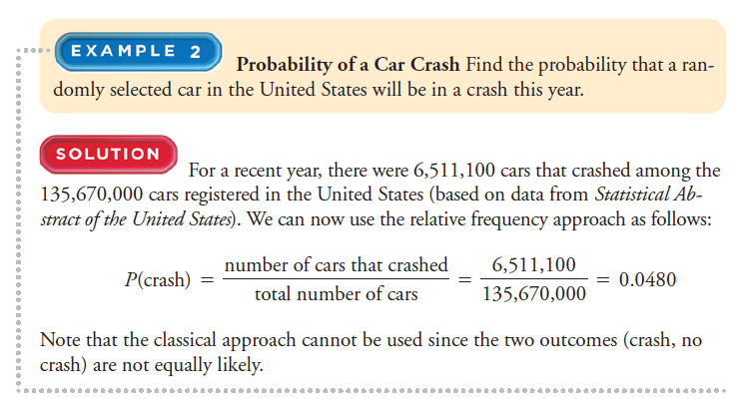

Slide 12
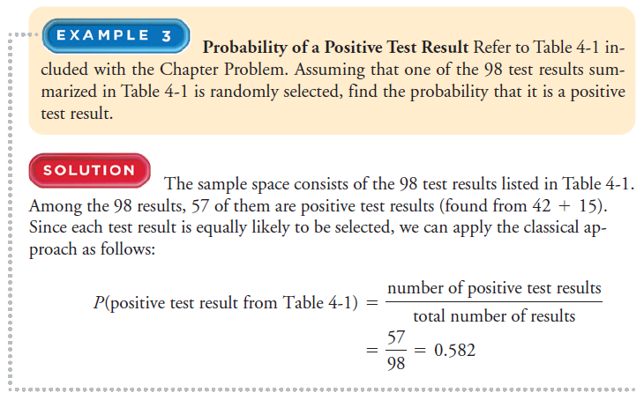

Slide 13
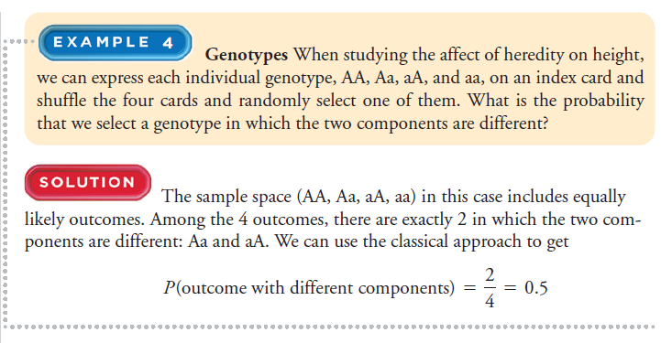

Slide 14
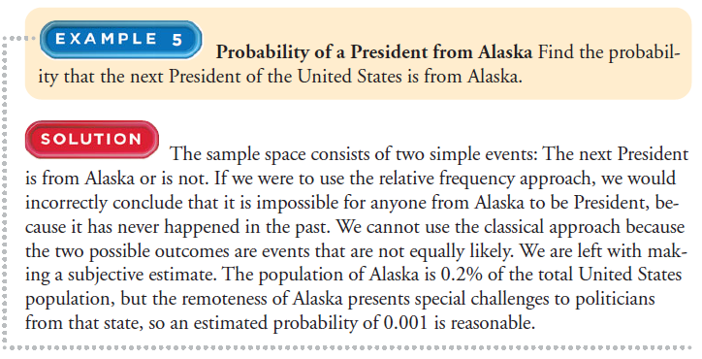

Slide 16
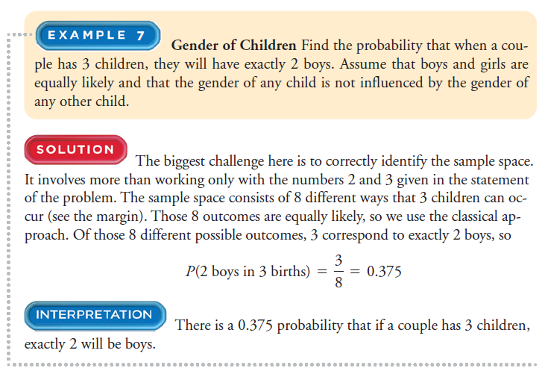

Slide 17
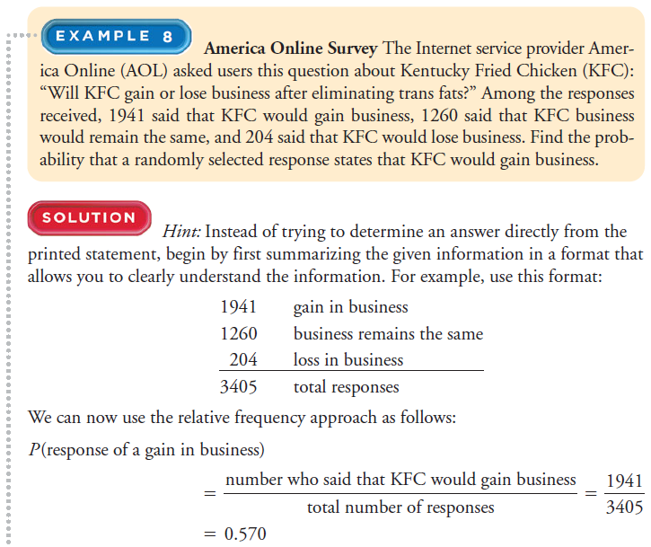

Slide 19
Identify the sample space of the probability experiment and determine probability the number of outcomes in the event.
LATIHAN SOAL
Procedure: tossing four coins
Event: getting three heads, getting two non-heads
Procedure: rolling 2 six-sided dice
Event: getting a sum of 4 or 5

Slide 20
Selesai..

